Slide 1
Instance Segmentation

Slide 2
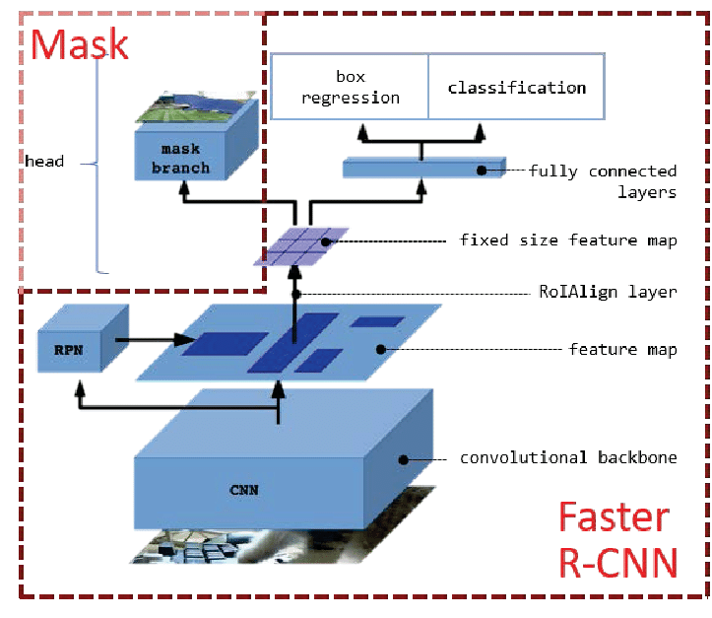
Architecture

Slide 3
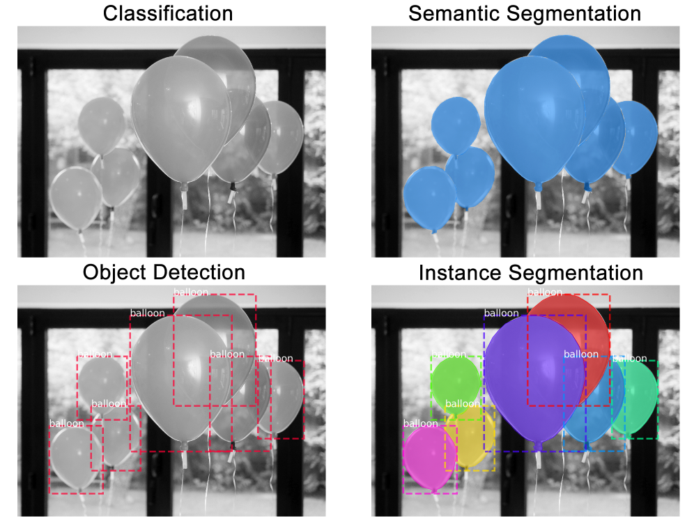
What is instance Segmentation
Instance segmentation is the task of identifying object outlines at the pixel level.
Classification: There is a balloon in this image.
Semantic Segmentation: These are all the balloon pixels.
Object Detection: There are 7 balloons in this image at these locations. We’re starting to account for objects that overlap.
Instance Segmentation: There are 7 balloons at these locations, and these are the pixels that belong to each one.

Slide 4
Backbone of Architecture
Our implementation uses a ResNet101 + FPN backbone.
What is FPN ?
Feature Pyramid Network (FPN) is a feature extractor designed for such pyramid concept with accuracy and speed in mind. It replaces the feature extractor of detectors like Faster R-CNN and generates multiple feature map layers with better quality information than the regular feature pyramid for object detection.
FPN composes of a bottom-up and a top-down pathway. The bottom-up pathway is the usual convolutional network for feature extraction. As we go up, the spatial resolution decreases.
FPN provides a top-down pathway to construct higher resolution layers from a semantic rich layer.

Slide 5
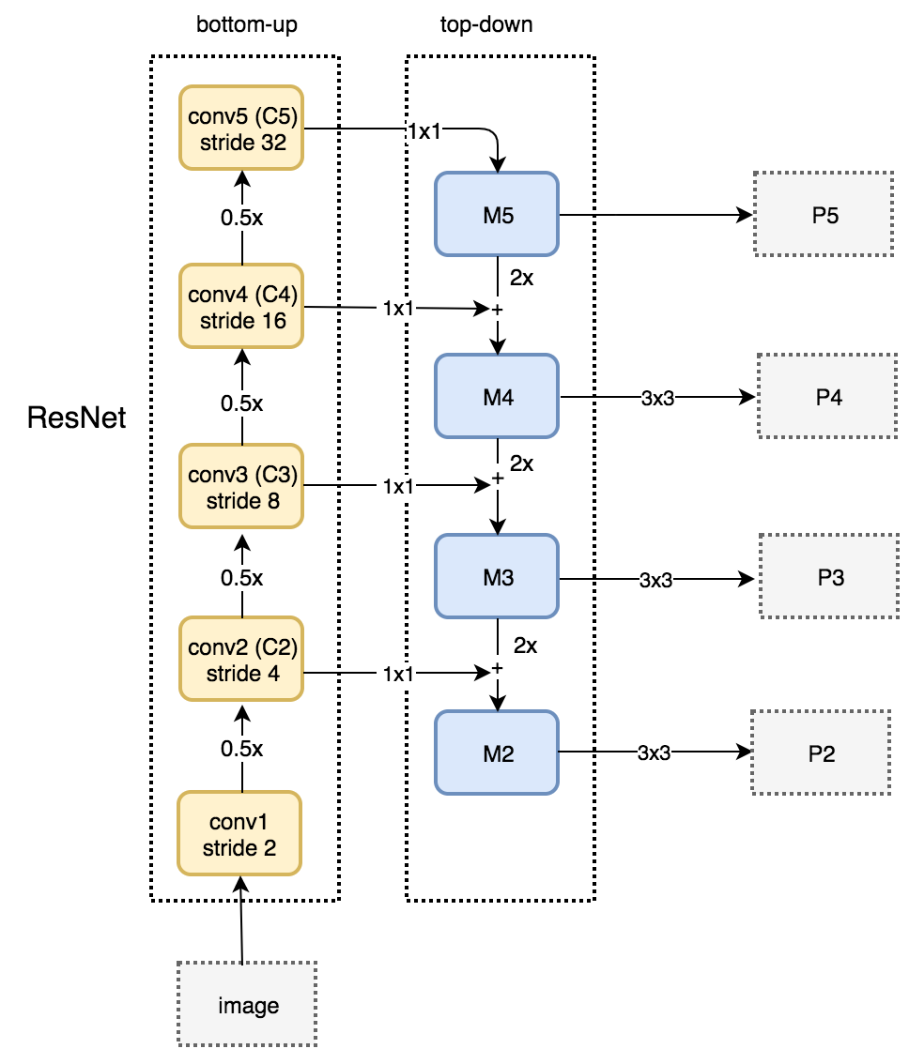
Bottom-Up Pathway
The bottom-up pathway uses ResNet to construct the bottom-up pathway. It composes of many convolution modules (convi for i equals 1 to 5) each has many convolution layers. As we move up, the spatial dimension is reduced by 1/2 (i.e. double the stride). The output of each convolution module is labeled as Ci and later used in the top-down pathway.

Slide 6
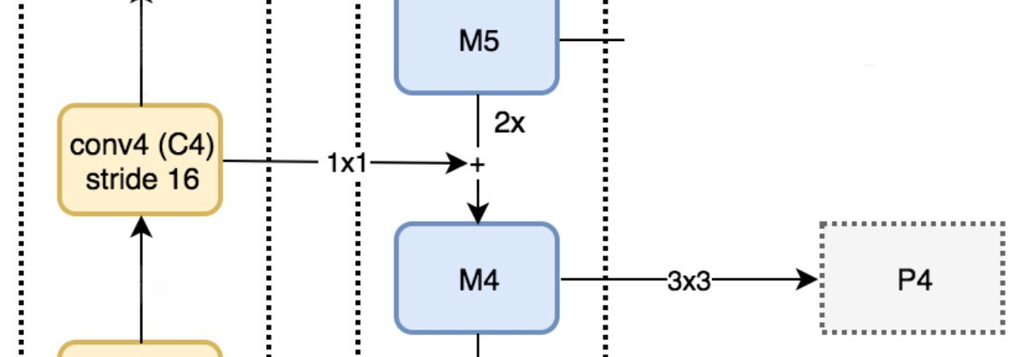
Top-Down Pathway
We apply a 1 × 1 convolution filter to reduce C5 channel depth to 256-d to create M5. This becomes the first feature map layer used for object prediction.
As we go down the top-down path, we upsample the previous layer by 2 using nearest neighbors upsampling. We again apply a 1 × 1 convolution to the corresponding feature maps in the bottom-up pathway. Then we add them element-wise. We apply a 3 × 3 convolution to all merged layers.

Slide 7
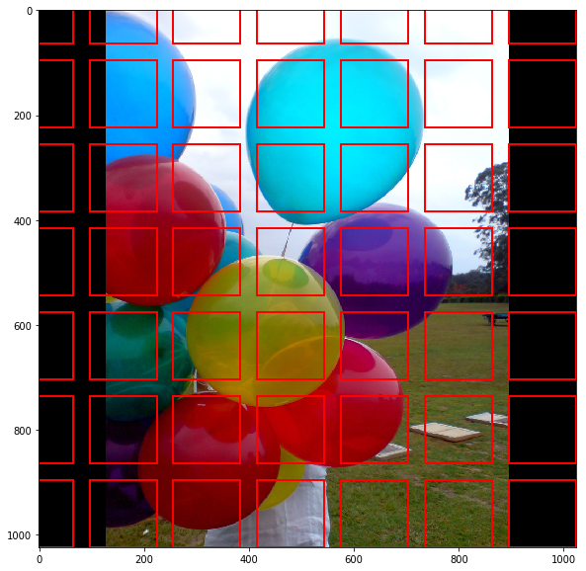
Region Proposal Network
FPN is not an object detector by itself. It is a feature extractor that works with object detectors.
The RPN is a lightweight neural network that scans the image in a sliding-window fashion and finds areas that contain objects.
The regions that the RPN scans over are called anchors. Which are boxes distributed over the image area, as show on the right.Further, the RPN doesn’t scan over the image directly . Instead, the RPN scans over the backbone feature map.

Slide 8
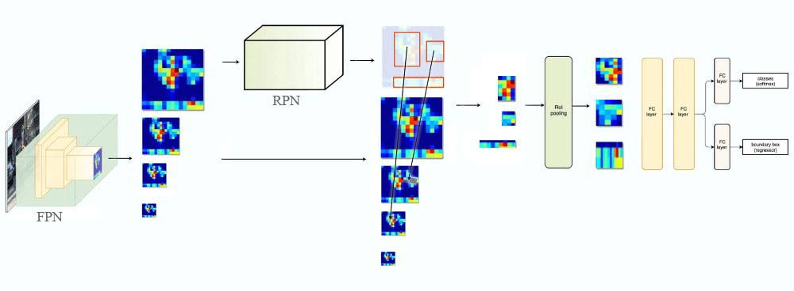

Slide 9
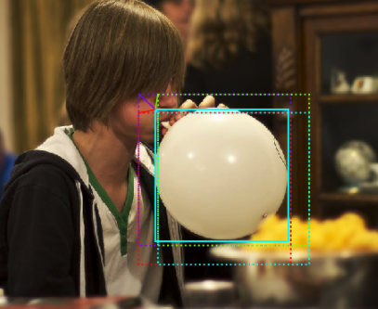
The RPN generates two outputs for each anchor:
Anchor Class: One of two classes: foreground or background. The FG class implies that there is likely an object in that box.
Bounding Box Refinement: A foreground anchor (also called positive anchor)
Using the RPN predictions, we pick the top anchors that are likely to contain objects.If several anchors overlap too much, we keep the one with the highest foreground score and discard the rest (referred to as Non-max Suppression). After that we have the final proposals (regions of interest) that we pass to the next stage.
3 anchor boxes (dotted) and the shift/scale applied to them to fit the object precisely (solid). Several anchors can map to the same object.

Slide 10
ROI Classifier
This stage runs on the regions of interest (ROIs) proposed by the RPN. As classifier can’t accept image of any varied size hence RoI align is necessary to perform. And just like the RPN, it generates two outputs for each ROI:
Class: The class of the object in the ROI. Unlike the RPN, which has two classes (FG/BG), this network is deeper and has the capacity to classify regions to specific classes (person, car, chair, …etc.). It can also generate a background class, which causes the ROI to be discarded.
Bounding Box Refinement: Very similar to how it’s done in the RPN, and its purpose is to further refine the location and size of the bounding box to encapsulate the object.

Slide 11
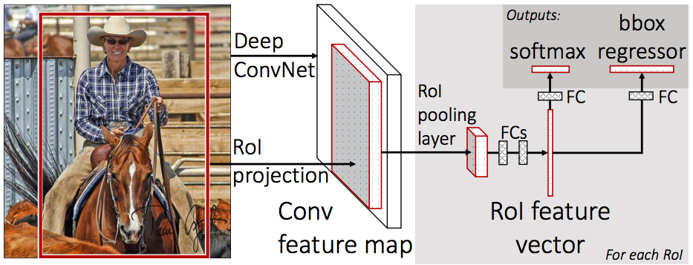

Slide 12
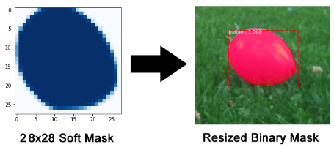
Segmentation Branch
The mask branch is a convolutional network that takes the positive regions selected by the ROI classifier and generates masks for them. The generated masks are low resolution: 28x28 pixels. But they are soft masks, represented by float numbers, so they hold more details than binary masks, during inferencing we scale up the predicted masks to the size of the ROI bounding box and that gives us the final masks, one per object.

